Slide 1
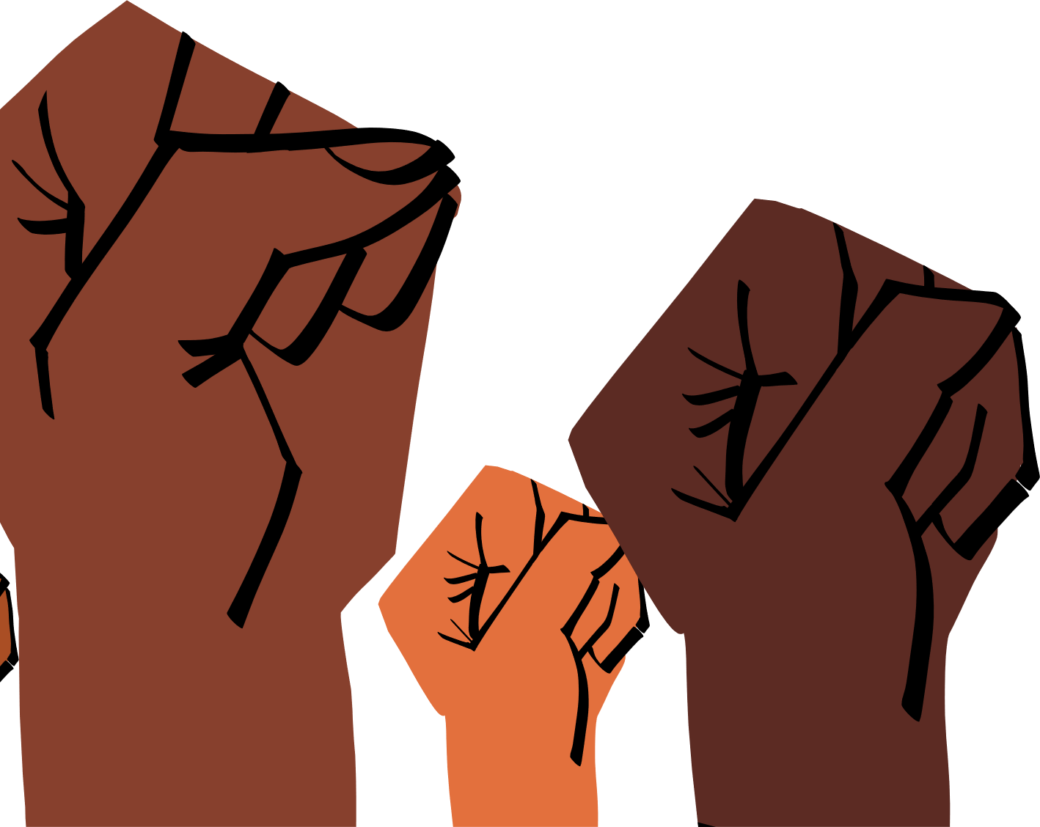
Association for Psychological Science Annual Conference
Upending
Racism in Our Science: Where the Rubber Meets the Road
Idia Binitie Thurston, PhD
Associate Professor of Psychology and Public Health, CHANGE Lab Director
Texas A&M University
Black, Immigrant, Woman (she/her), living and working on native lands of the Tonkawa, Tawakoni, Hueco, Sana, Wichita, and Coahuiltecan peoples
Notes:
The 2023 program, “Upending Racism in Our Science: Where the Rubber Meets the Road” will discuss how psychological science lacks diversity in topics, populations researched, scientists, reviewers of our science, and dissemination avenues and how this narrow lens stifles intellectual contributions, idea generation and scholarly innovation. This talk will highlight structural and procedural barriers holding psychological science back and offer concrete strategies to deviate from that norm.

Slide 2
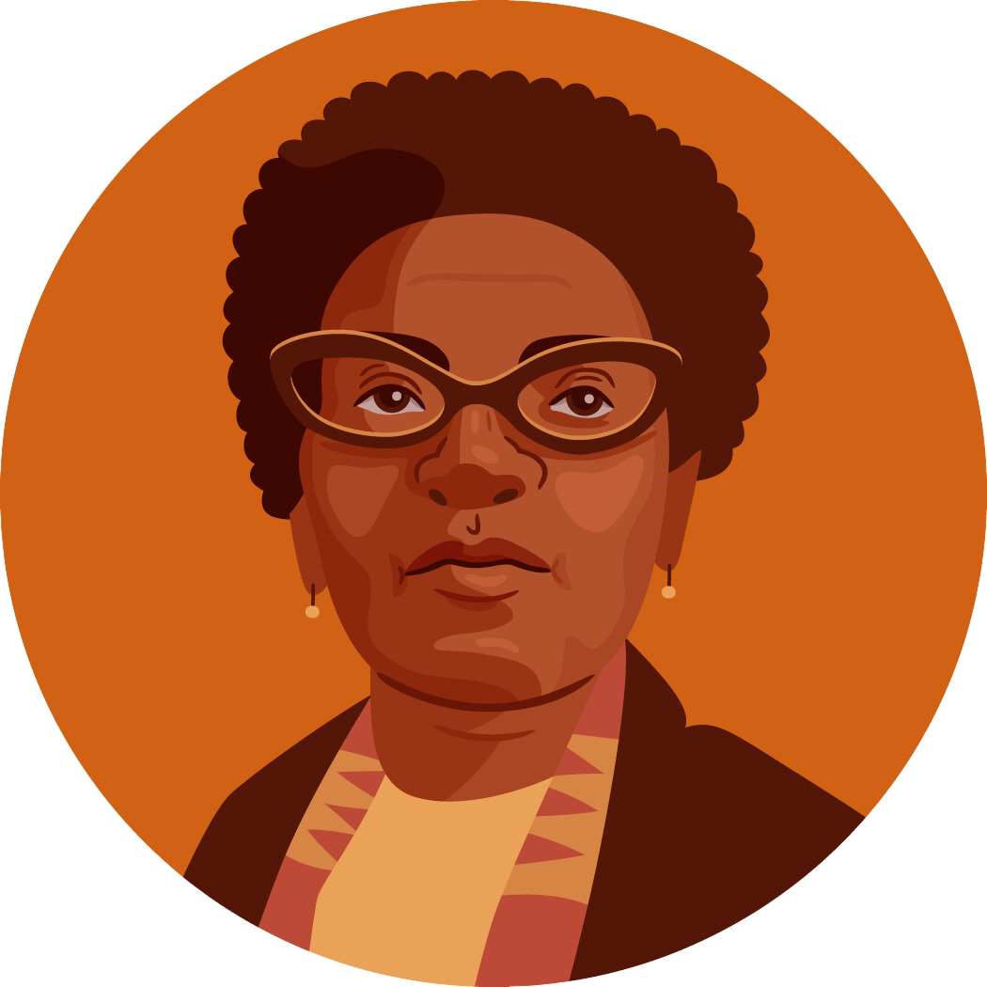
“There is no such thing as a single-issue struggle because we do not live single-issue lives."
-Audre Lorde
Notes:
I start my talk today with this quote by Audre Lorde because A. she is a goddess and B. this quote embodies all the things – it embodies how we live intersectional lives (we are never only one thing) AND how the struggle in our science to undo the singular lens that it has held means it is critical to address racism from a multi-issue lens - don’t just do one thing and expect change; we must do multiple things and be persistent!

Slide 3
2023
Feagin, 2021
The reality of U.S. history
How is racism operating here?
What is keeping racism going?
What action can I take to dismantle it?
Notes:
I invite a similar approach when attempting to upend racism in our science – the question isn’t is racism operating in our science – it is how is it operating, what continues to keep it going, and how can we start to reduce it. We reduce it by naming it, encouraging conversations like this about it, and funding initiatives to change it. If we all thought and wrote about how our work applies to people of color and people experiencing inequity – we will be successful in upending racism in our science
82% of our history involves state-sanctioned exclusion and violence toward Black members of our communities. I say this not to make anyone feel bad or shame or guilt. As a psychologist we know that shame and guilt DO NOT inspire lasting change. I say this to remind us of the legacy of this history andto provide us with the opportunity to reflect on how it is operating TODAY – so rather than wondering IS racism operating here, the question we need to ask is HOW is racism operating, because frankly how could it NOT be. And because of how racism contributes to exclusion, we also need to ask whose voice is NOT being centered and how can we bring those voices in.
Yet, data shows that these disparities affect us all regardless of whether we are from those marginalized groups or not because health care costs go up for all, when people don’t spend money it affects the economy overall, life expectancy is going down for all of us, etc.
As we recently addressed in the Feb 2023 Issue of the American Psychologist of which I was co-editor- health equity is an issue for ALL psychologists****

Slide 4
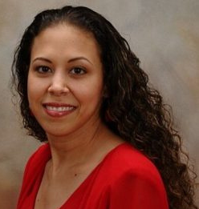
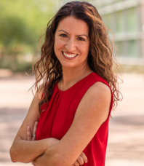
CONDUCTING RESEARCH
REPORTING & REVIEWING SCHOLARSHIP
DISSEMINATING FINDINGS
Notes:
Much of the work I will present today is based on this paper that my amazing friend-colleagues and I worked on during the pandemic. The pandemic was a time of reflection for many of us and a time of activation to do better and do different. WE harnessed our lived experiences and scientific knowledge to put together a passionate plea full of ideas for upending racism in our psychological science that we all love so much but which continues to engage in practices that uphold itself and excludes most of us. My talk today will draw on the knowledge of this paper and the numerous papers that have emerged inspired by this and other seminal papers. We choose to focus on how research is conducted, how it is reported and reviewed, and how it is disseminated –as key points in the research process where epistemic exclusion and marginalization occurs

Slide 5
How Research is Conducted

Slide 6
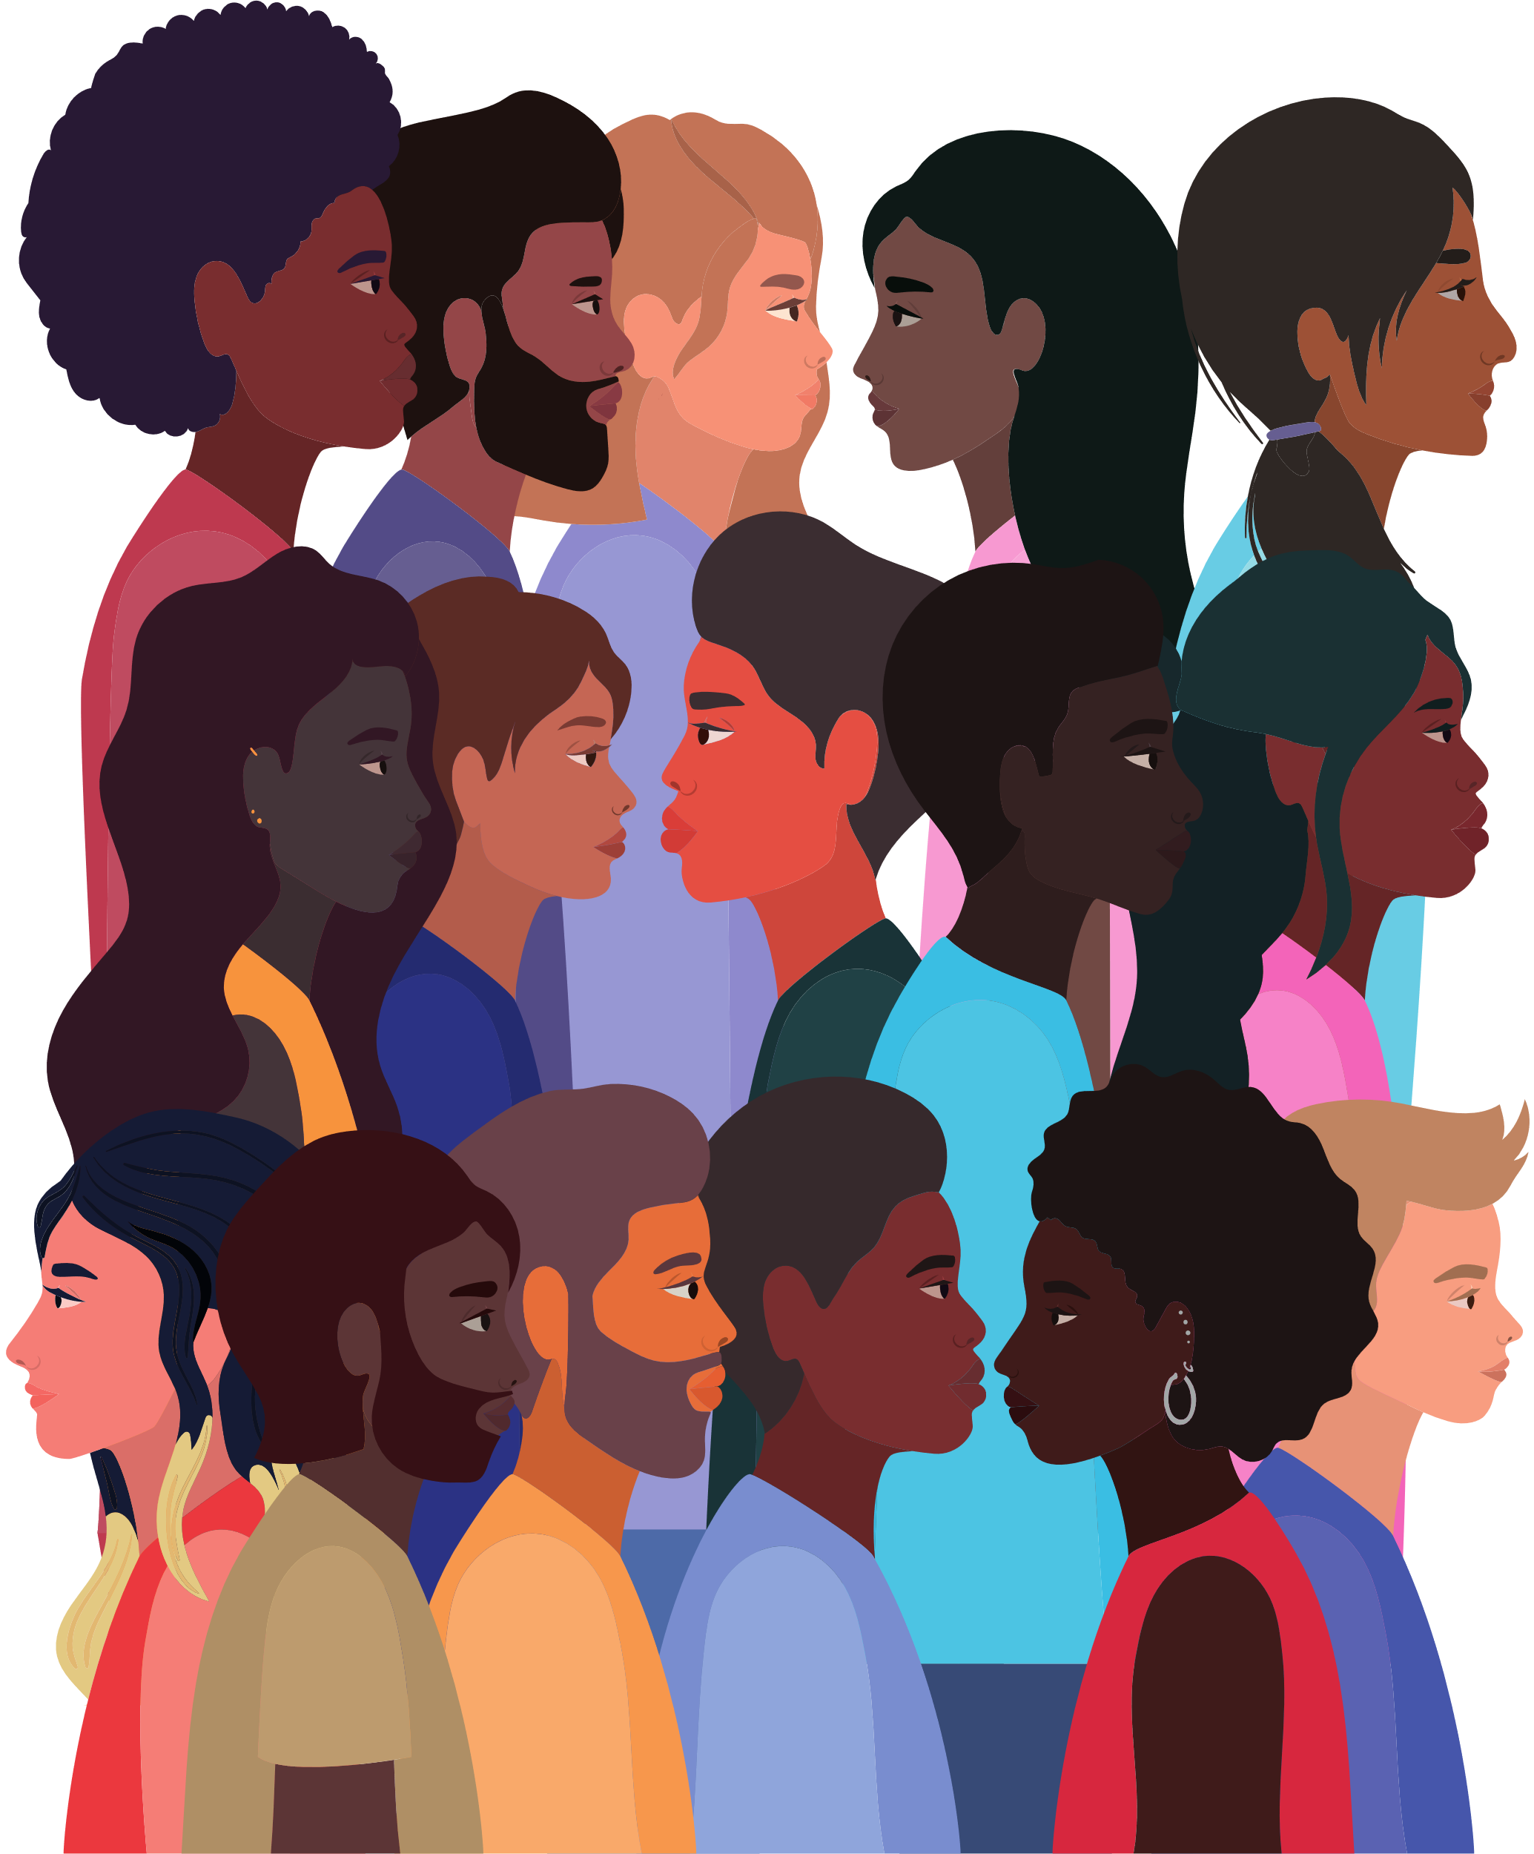
#1: Conduct and publish more research on race
Conduct more research and teach on diversity science theories and frameworks (Buchanan & Wiklund, 2021)
Require authors to address applications of work to populations of color and populations experiencing inequality (Roberts et al., 2020)
Detection
Understanding
Reduction
Notes:
Conduct and publish more research on race
-Conduct more research and teach on diversity science theories and frameworks. (A, E)
-Encourage research and papers on diversity topics. (E, J)
Featured Article: Valrie et al., 2020
In our special issue for the Journal of Pediatric Psychology, my co-editors and I framed the call to action around Kilbourne’s health disparities model. This model highlighted the pathway of addressing health disparities from detection of health inequities, to understanding factors driving those health inequities and finally reduction of the inequities. In this paper we invite pediatric psychologists to move toward understanding and reduction, rather than similar documenting the problem.
-Require authors to address applications of work to populations of color and populations experiencing inequality. (J, R)

Slide 7
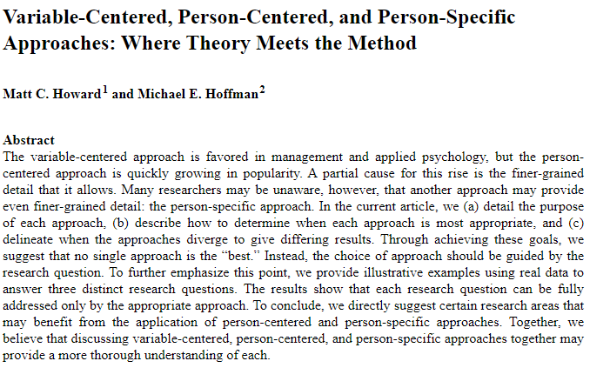
Conduct more research from a diversity science perspective and use research methods appropriate for BIPOC populations (Chávez et al., 2008)
Incentivize authors who submit research using diversity science approaches.
#3 and #5: Promote diversity science & research methods appropriate for BIPOC populations
Variable-Centered
Person-Centered
Person-Specific
Notes:
Promote Diversity Science & Research Methods Appropriate for BIPOC Populations
-Conduct more research from a diversity science perspective and use research methods appropriate for BIPOC populations (A)
-Encourage research that uses methods and analyses that may better capture heterogeneity in diverse samples. (J)
-Incentivize authors that submit research using diversity science approaches. (J, R)
Chavez and colleagues - To empower a community, we must become a community, supporting and challenging each other as we implement culturally competent, power- and race-sensitive inquiry. Dancing forward, following the flow of the dance of race and privilege in community-based participatory research, outside researchers must become comfortable with not always taking the lead but often dancing side by side with the community and sometimes following the community’s lead.
Featured Article: Howard & Hoffman, 2018
-Train students on diversity science theory and diverse research methods such as CBPR and decision-making for research methods selection (E)
-Highlight the importance of recruiting diverse samples in graduate-level research methods courses (E)

Slide 8
How research is reported

Slide 9
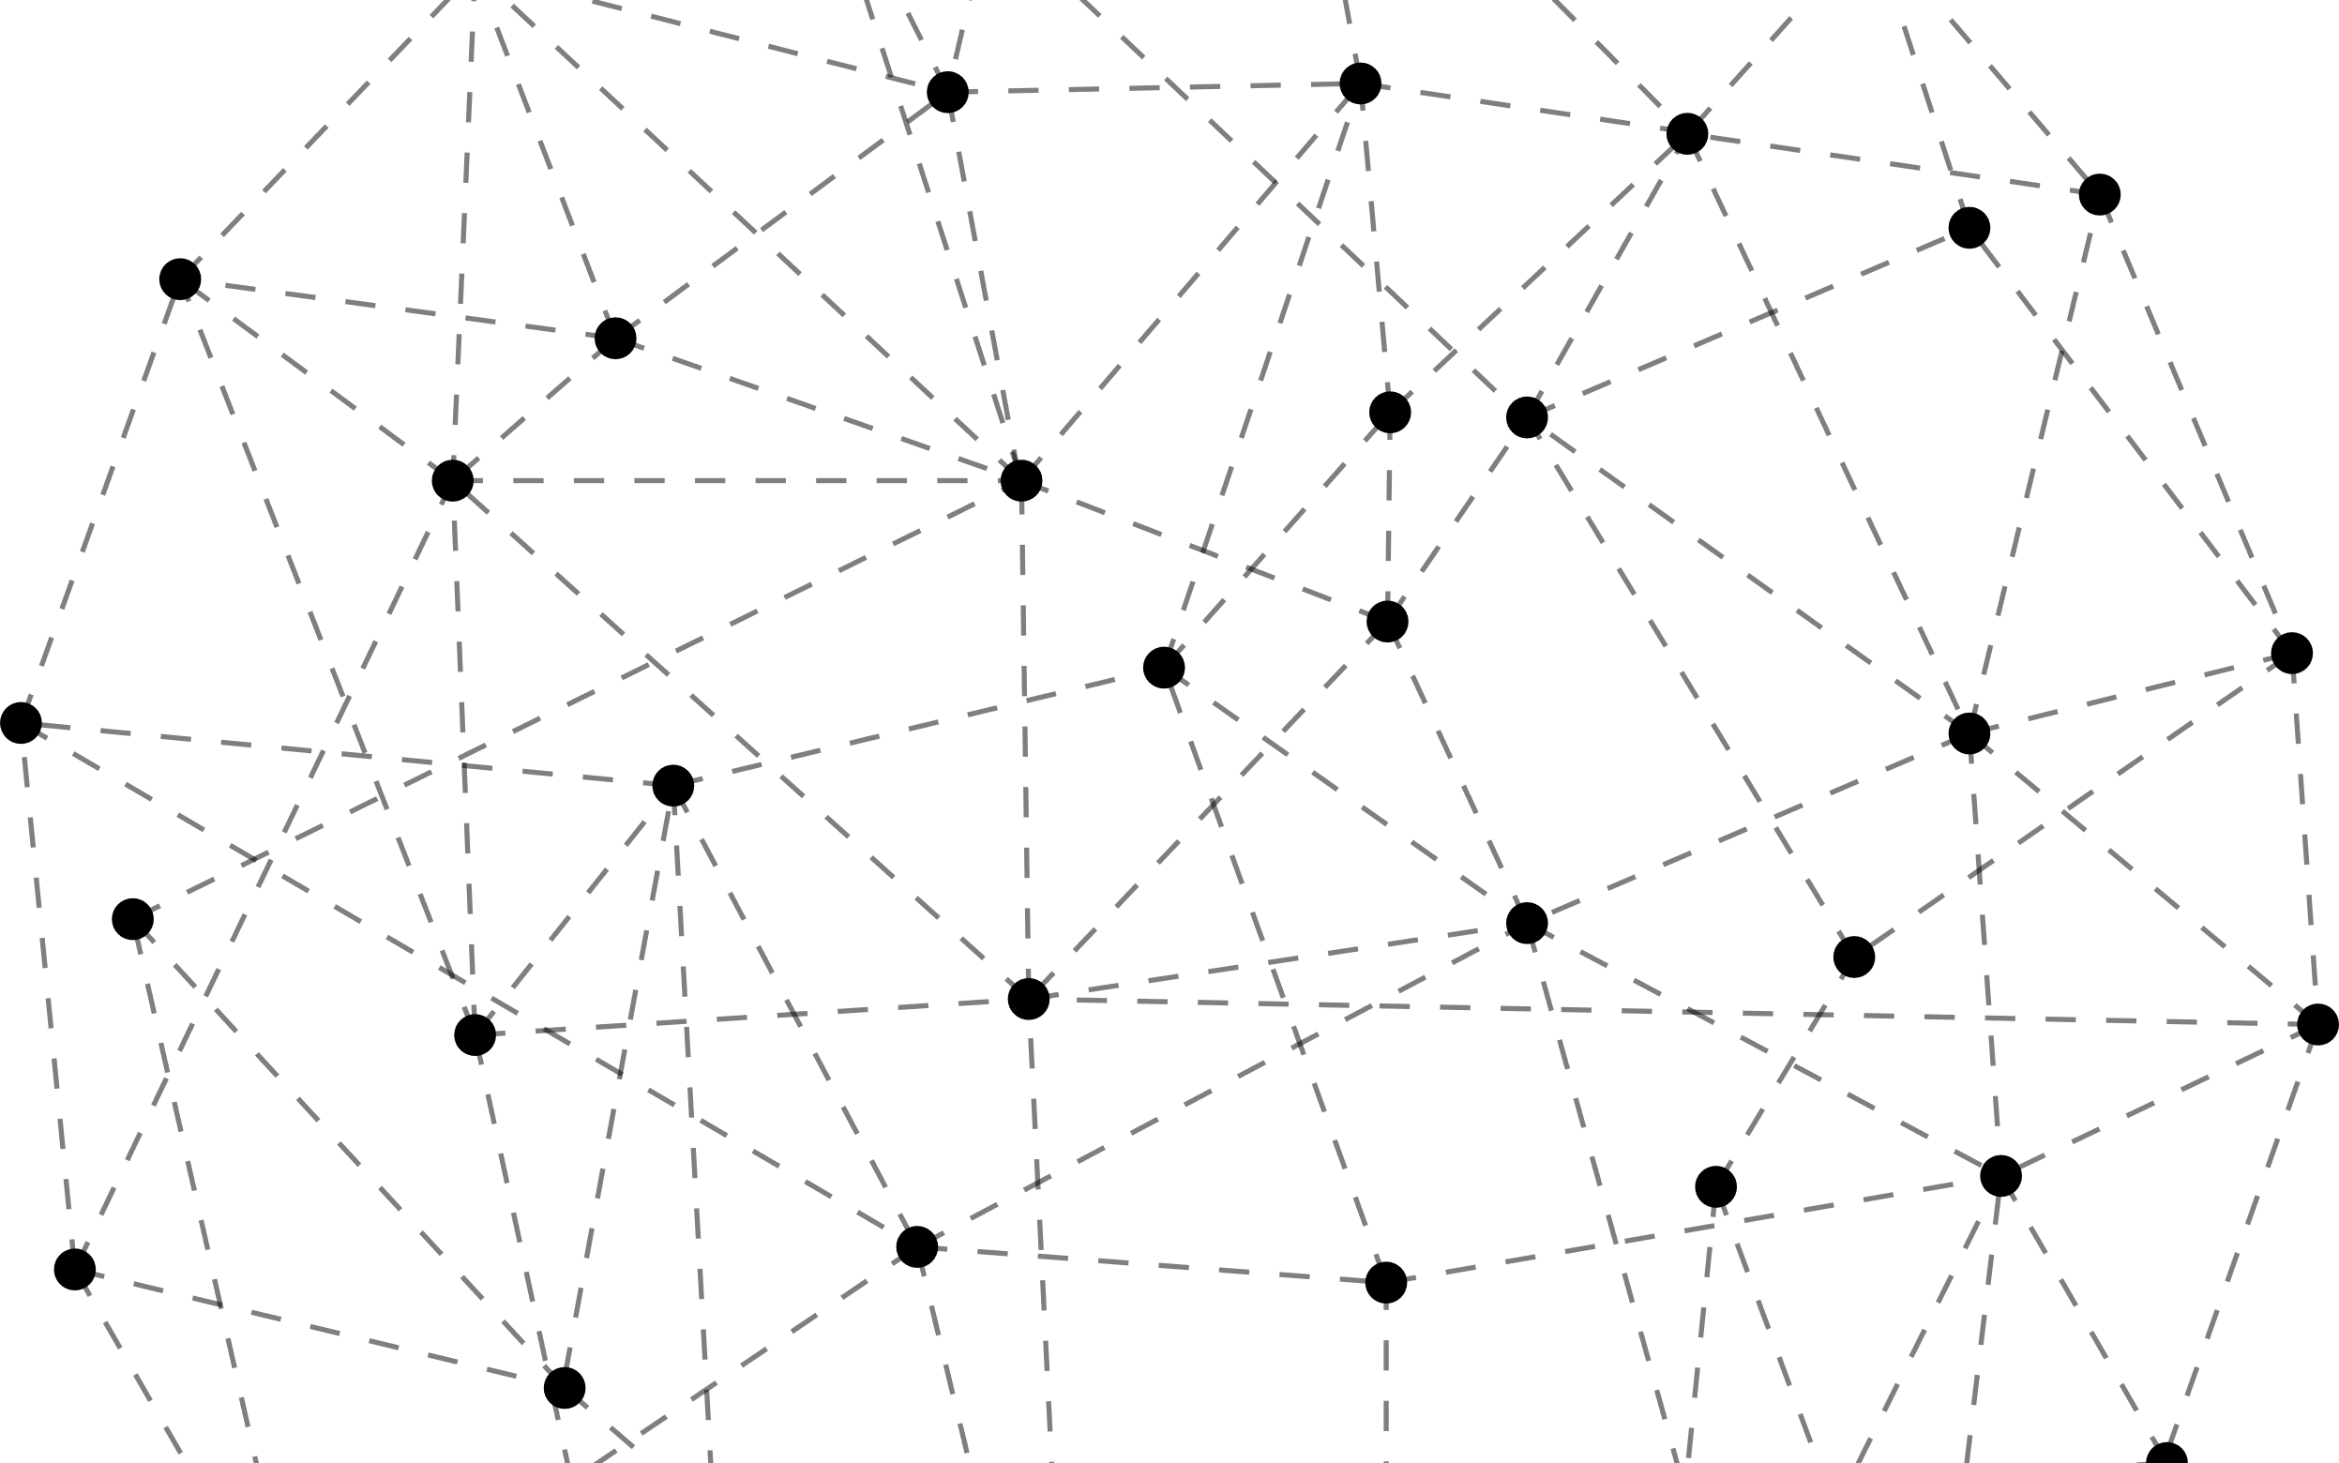
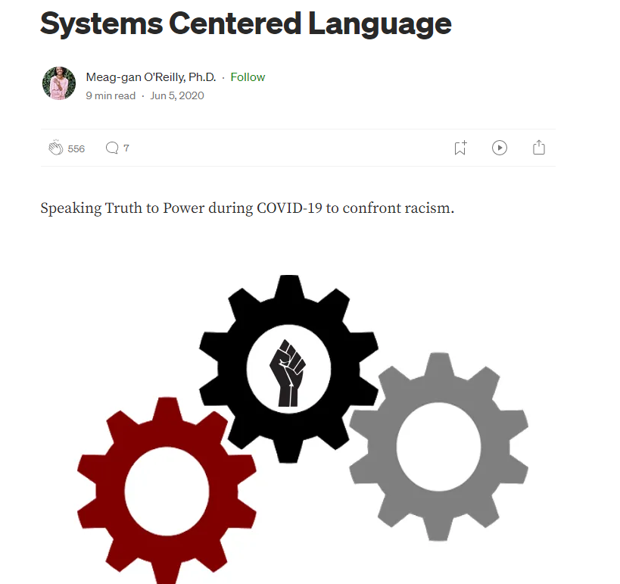
#6: Require the use of system centered language (SCL)
Train students on SCL and have them practice writing in this manner (O'Reilly, 2020).
Update author guidelines to require the use of SCL (Buchanan et al., 2021).
HIV disproportionately affects Black and Latino MSM.
HIV systematically impacts Black and Latino MSM who often face barriers such as medical racism and the cost of STI/HIV testing and PrEP.
Notes:
Require the use of SCL
-Train students on SCL and have them practice writing in this manner. (E)
-Update author guidelines to require the use of SCL. (J)
-Train reviewers and editors on use of SCL. (J, R)
-Add SCL to the next revision of the APA Publication Manual (J)
-Require authors to attest that they used SCL in manuscript submission portals. (J)
-Review manuscripts for person-first language and SCL. (A, E, J, R)
Everything you write about a group experiencing marginalization – be explicit about why that is or why it could be – so that the association between that group and bad outcomes is contextualize and we break the stereotype cycle of teaching future readers of our work that X group is always associated with bad things, as if they were born that way when it is actually a function of the state sanctioned policies that gave to some and restricted others
Featured Article: O’Reilly, 2020
-Frame results within the systemic structures that maintain disparate outcomes when interpreting findings. (A)

Slide 10
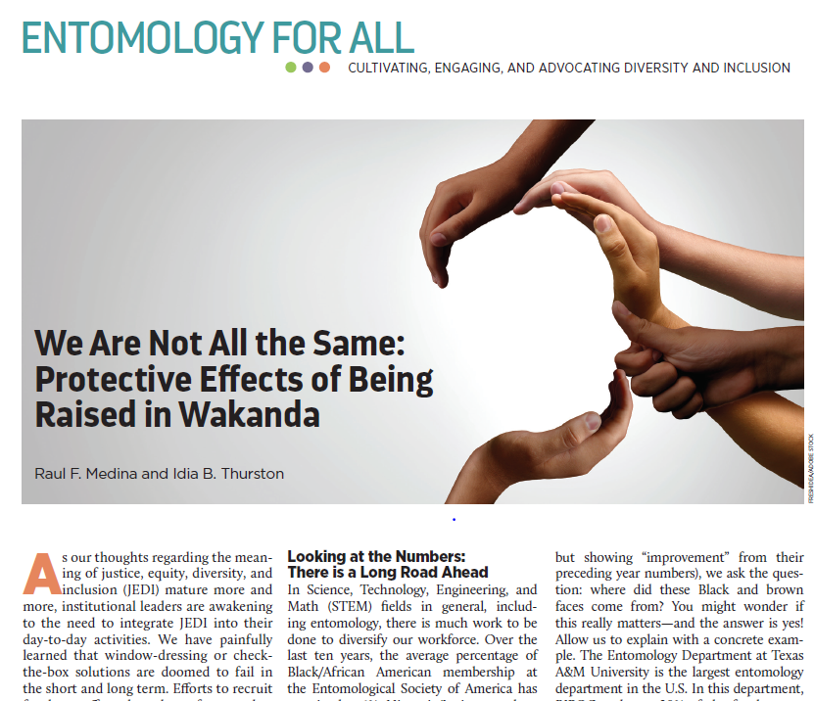
#10: Report race/ethnicity & within group heterogeneity
Report race/ethnicity for all participants to reflect the richness of ethnicities within groups (Buchanan & Wiklund, 2021)
Examine if findings are similar or different across demographic groups when possible (Yang & Chen, 2019).
Limit discussion of study generalizability to those demographic groups appropriately represented among participants (Flanagin et al., 2021; Roberts et al., 2020).
Notes:
Require reporting of ethnicity for all participants & Report heterogeneity within BIPOC populations
-Require ethnicity to be reported for all participants to reflect the richness of ethnicities within groups. (A, E, J, R)
-Describe how ethnicity was determined and if participants could endorse multiple identities. (A, E)
-Require that all relevant participant demographics and intersecting identities be reported. (A, E, J, R)
-Require authors to discuss as a limitation if they do not provide ethnicity data for all participants or had inadequate assessments of ethnicity. (A, J, R)
-Train students on the diverse ways one can assess ethnicity and the importance of considering context. (E)
-Train students how to report all relevant participant demographics including intersecting identities. (E, J, R)
-Examine if findings are similar or different across demographic groups when possible. (A, E, J, R)
-Limit discussion of study generalizability to those demographic groups appropriately represented among study participants. (A, E, J, R)
Featured Article: Medina & Thurston, 2022

Slide 11
Reviewer #1: Wow! I love this! You were born to write research
How Research is Reviewed
Reviewer #2: This is a dumpster fire

Slide 12
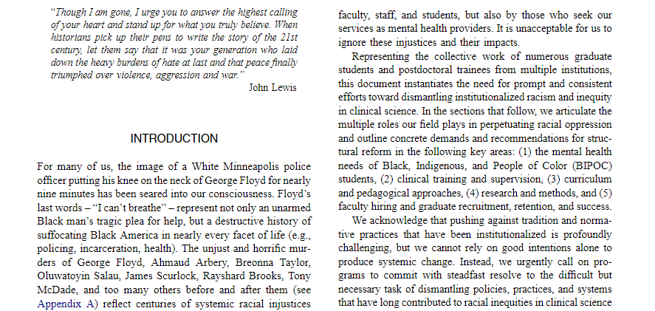
#12 Implement changes at the top that address ongoing racism in the review process
Examine existing journal leadership and develop procedures that promote equitable practices in leadership selection (Roberts et al., 2020)
Evaluate journals on metrics related to BIPOC presence in authorship, editorial membership, and content (Buchanan et al., 2021)
Notes:
Featured Article: Galán et al., 2021
Consider a candidate's abilities and track record in creating an equitable environment when vetting editors (e.g., require candidates to submit diversity statements

Slide 13
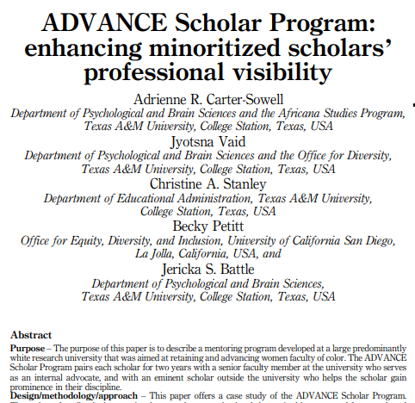
#18: Mentor and recognize BIPOC scholars engaging in the service of editing/reviewing
Encourage and provide team-based reviews as professional development opportunities (Society of Pediatric Psychology, n.d.).
Provide letters that recognize and reward BIPOC individuals for their national service contributions.
Notes:
Featured Article: Carter-Sowell et al., 2019
Establish formal mentorship programs within professional societies to cultivate the development of future BIPOC editors.
Provide letters that recognize and reward BIPOC individuals for their national service contributions.
SPP Board has implemented this, Ford Foundation has also implemented this

Slide 14
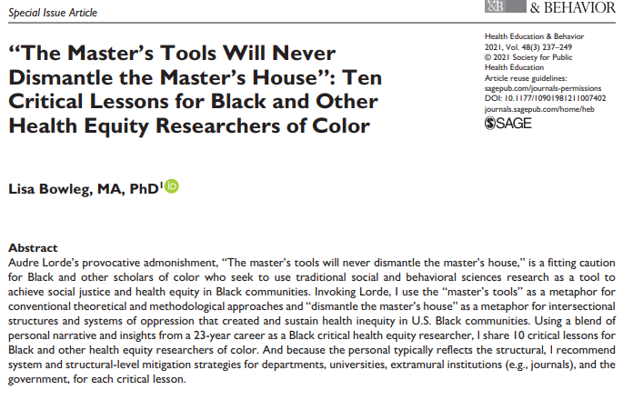
#22: Empower ALL authors to educate the field about race
Train ALL students on the added value of BIPOC-centered scholarship to the field (Galán et al., 2021)
Educate readers and reviewers on how to push back against biased comments in the editorial process (APA, 2021)
E.g., when comments about generalizability of research findings are raised
Notes:
Empower authors to educate the field about race
Update training programs for psychological scientists to explicitly discuss and train students on the added value of BIPOC-centered scholarship
scholars publishing on BIPOC-centered topics have to skillfully critique why prior research by white authors or on white populations as they may not be applicable to their sample
Because BIPOC-centered scholarship tends to be segregated to specialty journals (and thus read less often by white scholars) and because there are few BIPOC scholars, there are few qualified experts able to evaluate research on BIPOC populations; putting a higher burden on BIPOC authors to provide substantial didactic material to support the significance of the research and BIPOC reviewer to evaluate a range of topics
-Train students to value and describe how studies of BIPOC populations contribute to the literature and the field. (E)
-Educate readers and reviewers on how to skillfully rebut biased comments in the editorial process. (A, J, R)
A program excelling in this category would:
Support and lead educational and training efforts that raise awareness about the value of BIPOC scholarship, bias in prior work, and the need to upend racism in psychological science
Featured Article: (Bowleg, 2021)
Train students/scholars to proactively challenge and rebut common biases about BIPOC scholarship and promote the significance of BIPOC research. (A, E)
Lisa Bowleg: These lessons are risky. All threaten the White supremacist status quo, and consequently, tenure and promotion prospects, harmonious relationships with students and colleagues, grant proposal funding, and peer-reviewed publication. But as Lorde (1979/1984a) wisely observed, when we use “the tools of a racist patriarchy . . . to examine the fruits of that same patriarchy[,] it means that only the most narrow perimeters of change are possible and allowable” (p. 111). Herewith are 10 lessons to prompt Black and other health equity researchers of color to radically imagine their research as a transformative tool to advance health equity

Slide 15
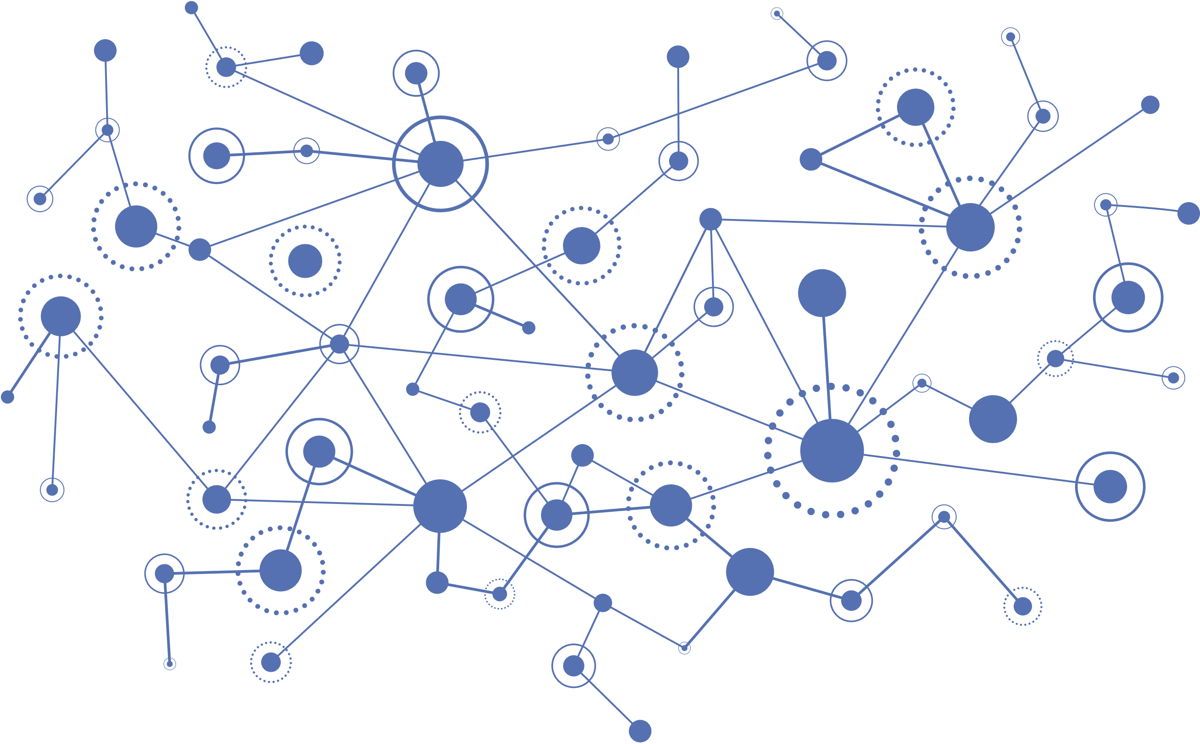
How Research is Disseminated

Slide 16
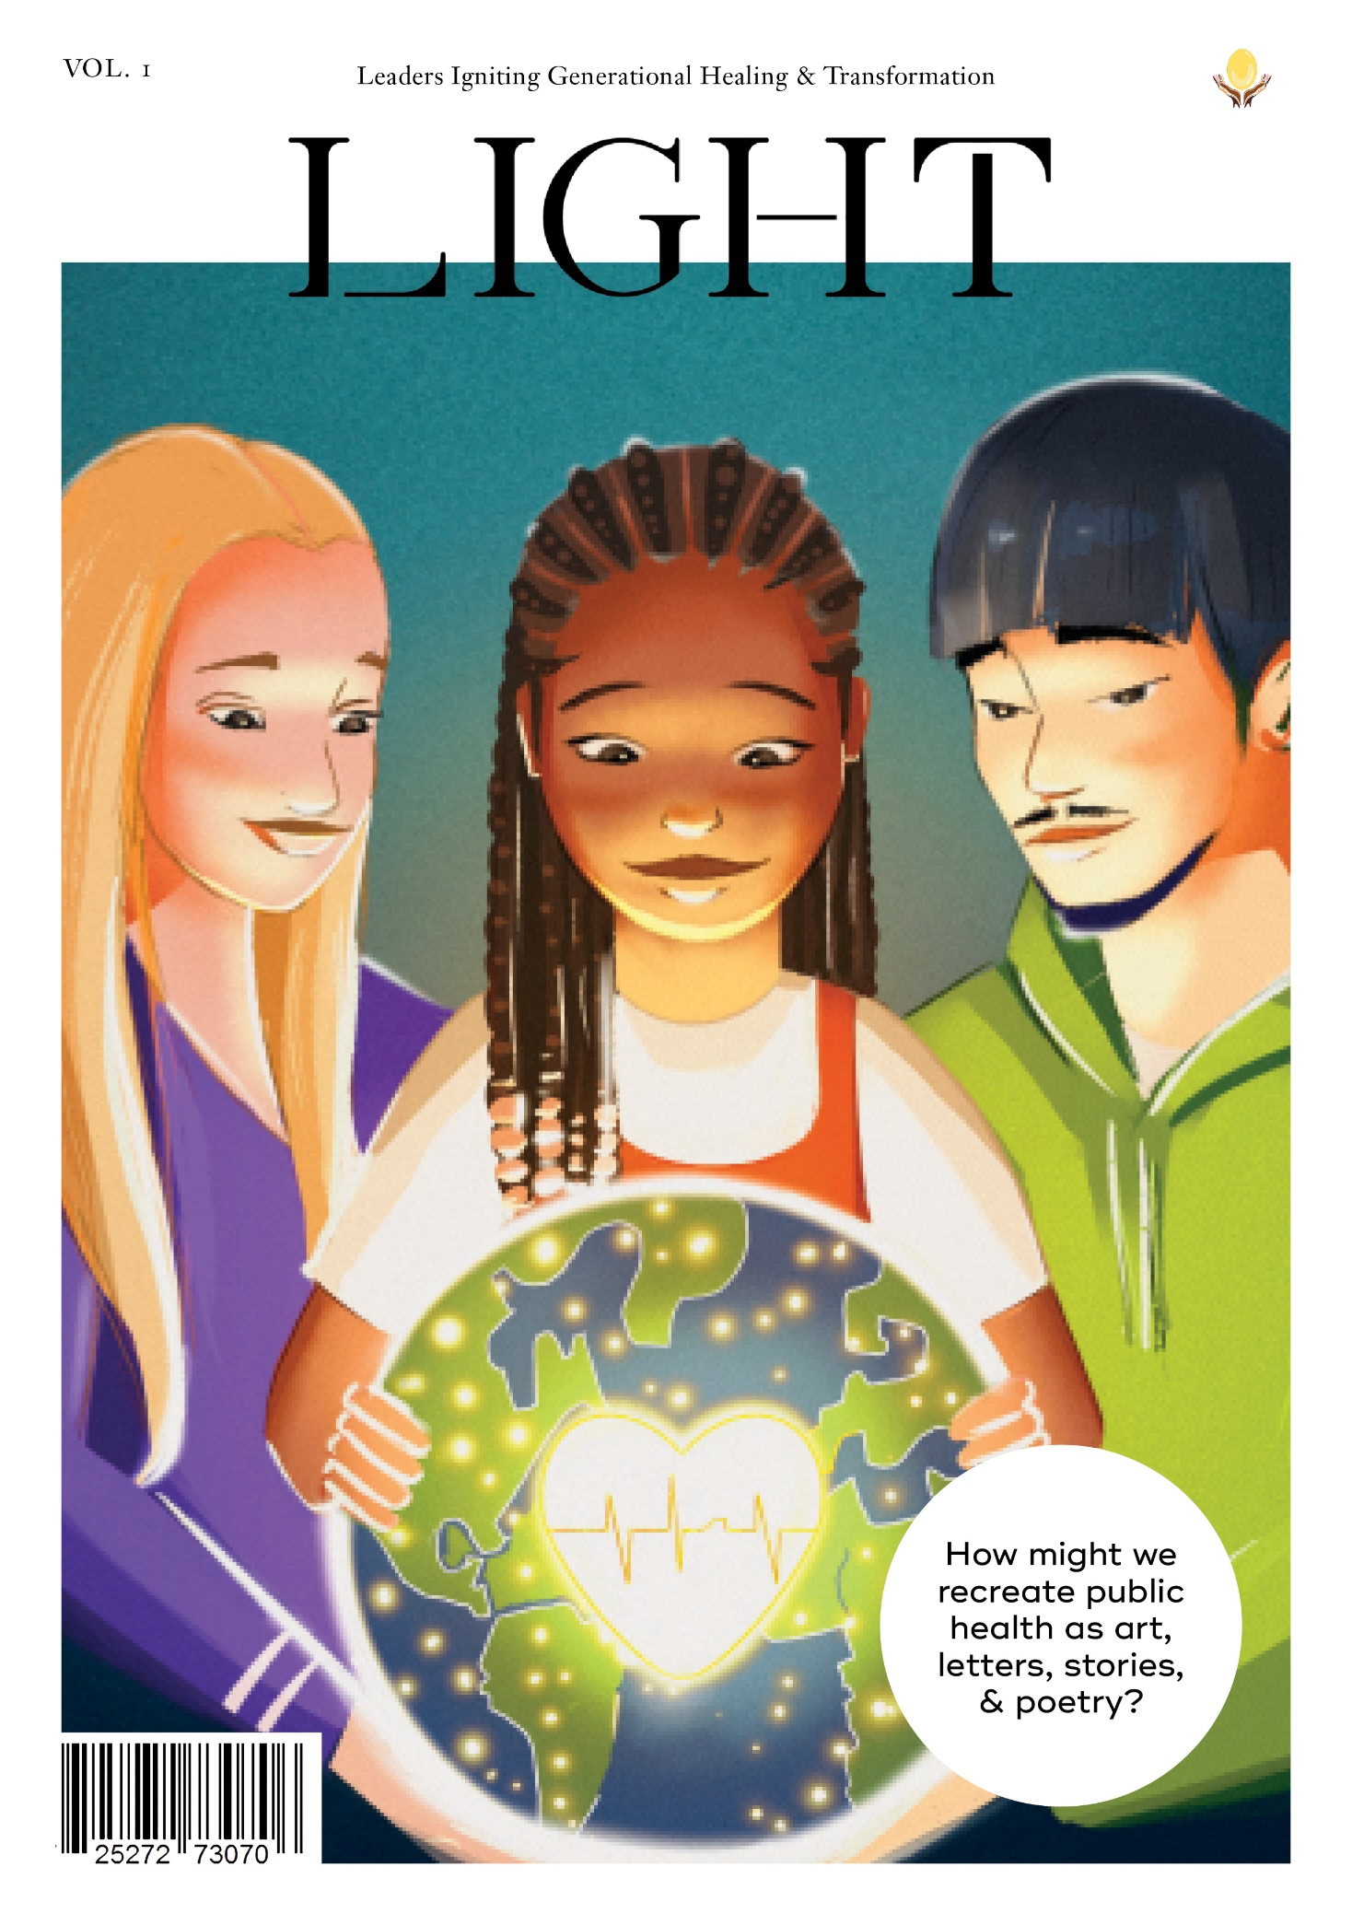
#24: Create public-focused dissemination strategies that extend to BIPOC communities
Encourage the use of innovative dissemination tools that extent the reach of science to the community (Råbu et al., 2020)
E.g., podcasts, infographics, research briefings, open access/practice oriented journals
Disseminate research findings in a variety of formats relevant to BIPOC communities (Bañales et al., 2023)
Have dedicated staff with specialized dissemination skills (McNeal et al., 2021)
Notes:
Create public-focused dissemination strategies that extend to BIPOC communities
Promote and support innovative dissemination tools to extent the reach of our science broadly and specifically to BIPOC communities
- Journals should build upon strategies like Altmetrics, which offer ways to assess community and public impact beyond journal citations
- Open access and practice-oriented journals offer ways to get our science utilized and into the hands of the public and news media outlets who can utilize the work
- Research briefings tailored for policy makers and health officials should be encouraged
- Infographics, podcasts, op eds, and other emerging formats should be promoted and tailored to BIPOC communities
-Disseminate research findings in a variety of formats relevant to BIPOC communities (e.g., practice-oriented journals, social media, infographics, podcasts, and emerging formats) to extend the reach of the science. (J)
-Ensure there are dedicated staff members with the specialized skills needed to broadly disseminate scientific findings across a variety of platforms that are broadly accessible, easily understood, and relevant to BIPOC communities. (J)
A journal excelling in this category would:
Track the proportion of papers whose findings were directly disseminated to the public and BIPOC communities & report on these numbers annually
Featured Article: LIGHT

Slide 17
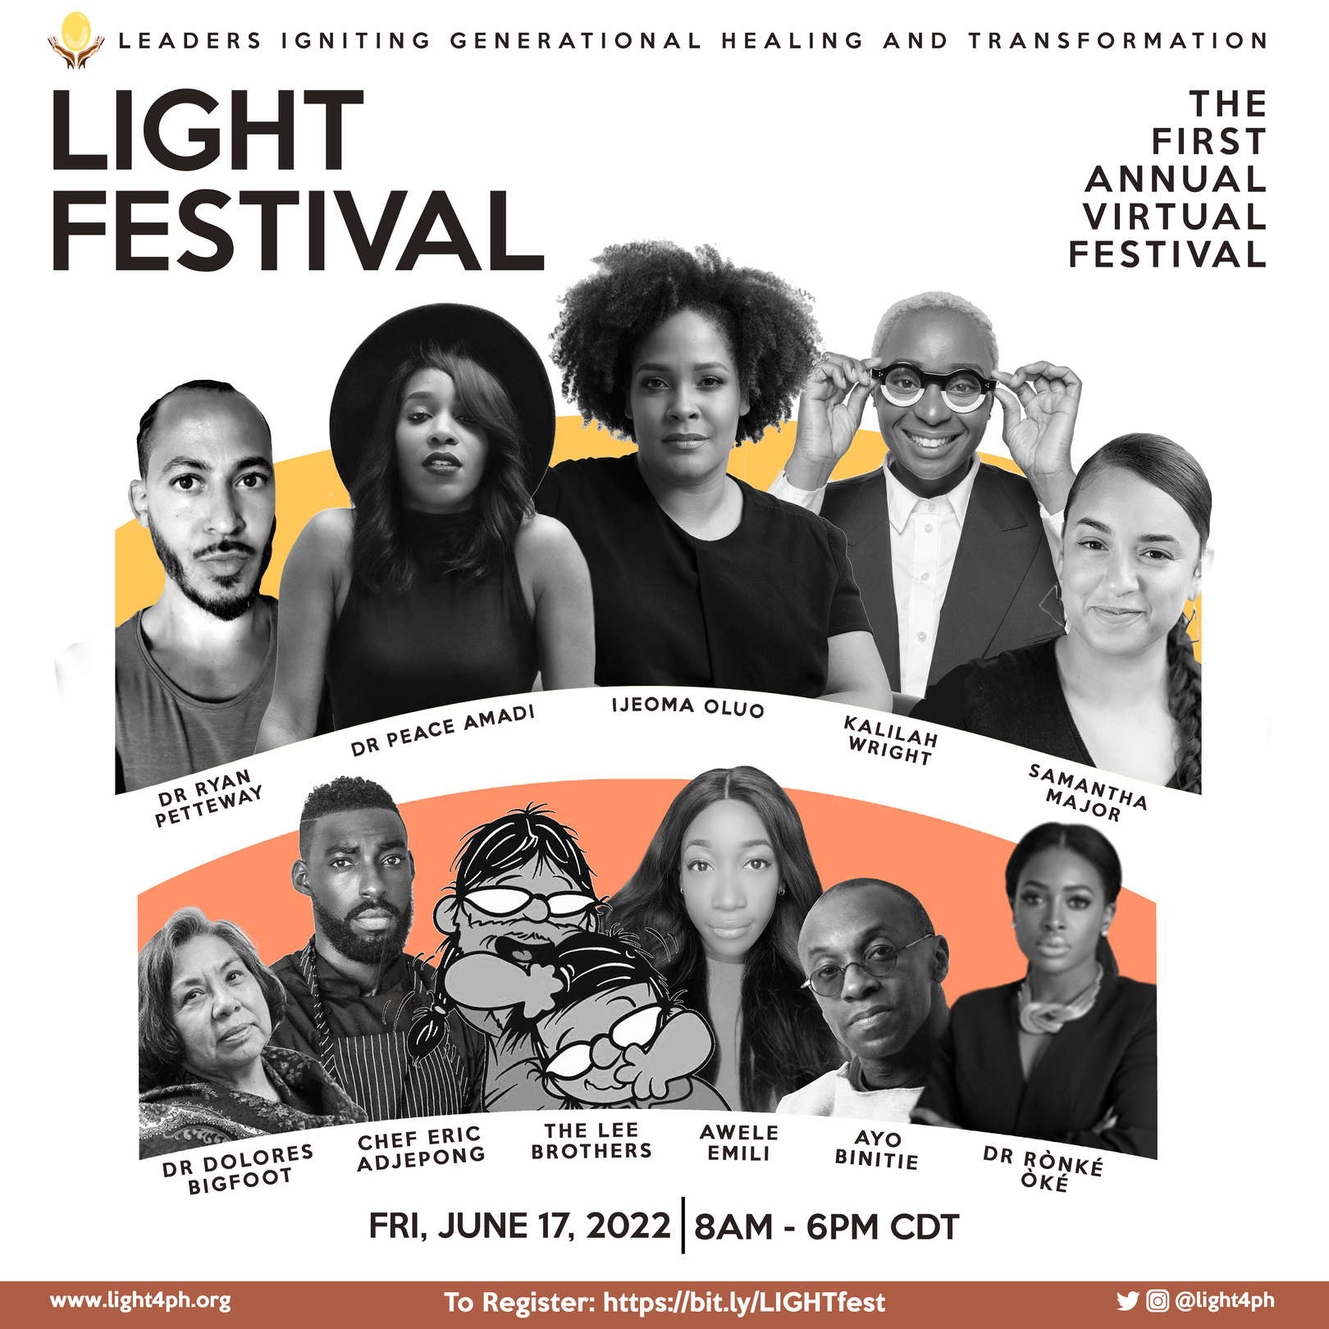
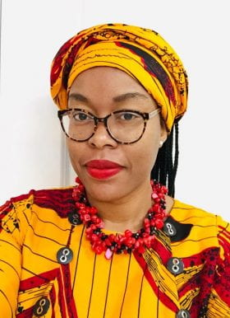
Leaders Igniting Generational Healing and Transformation - LIGHT
Dr. Juliet Iwelunmor, PhD
Website: light4ph.org
Twitter: @light4ph

Slide 18
Work with community partners to disseminate findings in a range of outlets (Evans et al., 2023)
Encourage community partners as co-authors (Schulz et al., 2023)
#25: Collaborate with community partners for dissemination
Notes:
Collaborate with community partners for dissemination
THIS SHOULD BE REWARDED WHEN DONE
TRACK REJECTION RATES FOR DESK REJECTS AND REVIEWED PAPERS
- Scientists are notoriously poor at sharing their science with the public
- CBPR principles include collaboration with community partners at all stages of the research process including dissemination of findings
- Scientists do not need to go alone in this process, harness your connections with communities and if you don’t have any use this opportunity to build those connections.
- When community partners are coauthors, dissemination to the communities impacted by research can occur more seamlessly and naturally.
- Work together with community partners to disseminate findings in scientific and non-scientific outlets. (A, J)
A journal excelling in this category would have:
Over 33% of papers with community partners as co-authors
Featured Article: Williford et al., 2023

Slide 19
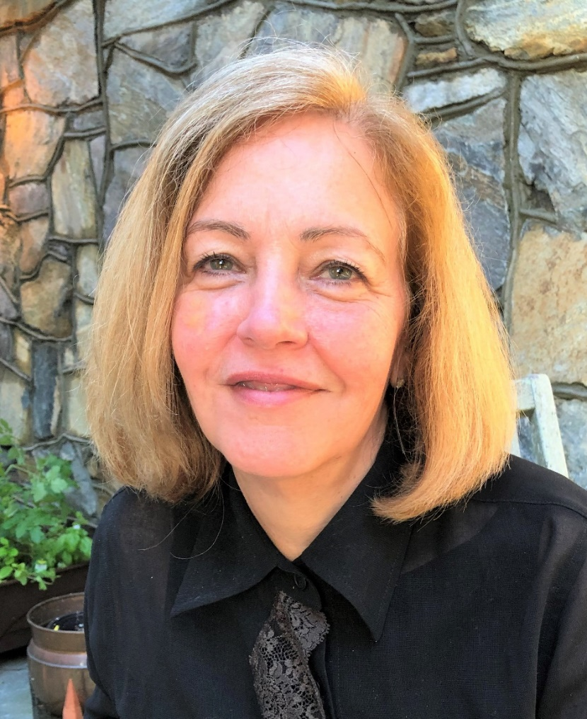
Increasing Diversity, Equity, and inclusion in Academic health Sciences - IDEAS
1
8
Policies correcting for past
discrimination
2
Embedding learning strategies
9
Utilizing holistic frameworks
3
Fostering emotional and social support
10
Embedding anti-racism
4
Strengthening scholar networks
11
Pathway programs
5
Outcome measurements and dashboards
12
Institutional Partnerships
Margarita Alegria, PhD
6
Commitment to diversity and inclusion in mission
DEI Committees
13
7
Financial Support
Mentorship & sponsorship
Notes:
In addition to the 25 items in our paper – we also need to diversify our science AND support BIPOC scientists to thrive in academia
In conducting a scoping review of 366 articles published from 1960 to 2022, quantitative interviews with over 300 participants, and qualitative interviews with 60 faculty, students, staff, and administrators, we found 13 strategies with some evidence of success (weak to moderate) in diversifying the academic health sciences field.
1. Policies correcting for past discrimination
2. Holistic frameworks supporting diverse recruitment and admission
3. Embedding anti-racism (in curriculum, teaching, mission, learning)
4. Pathway programs
5. Institutional partnerships – between HBCUs, HSIs, HWU
6. DEI committees
7. Mentorship & Sponsorship of minoritized and junior faculty
8. embedding learning strategies that center the needs of minoritized folks
9. Fostering emotional and social support
10. Strengthening scholars' networks
11. Collecting outcome measurements and having transparency via dashboards
12. Commitment to diversity and inclusion being visible and in mission and values statements
13. Providing financial support for the initiatives

Slide 20
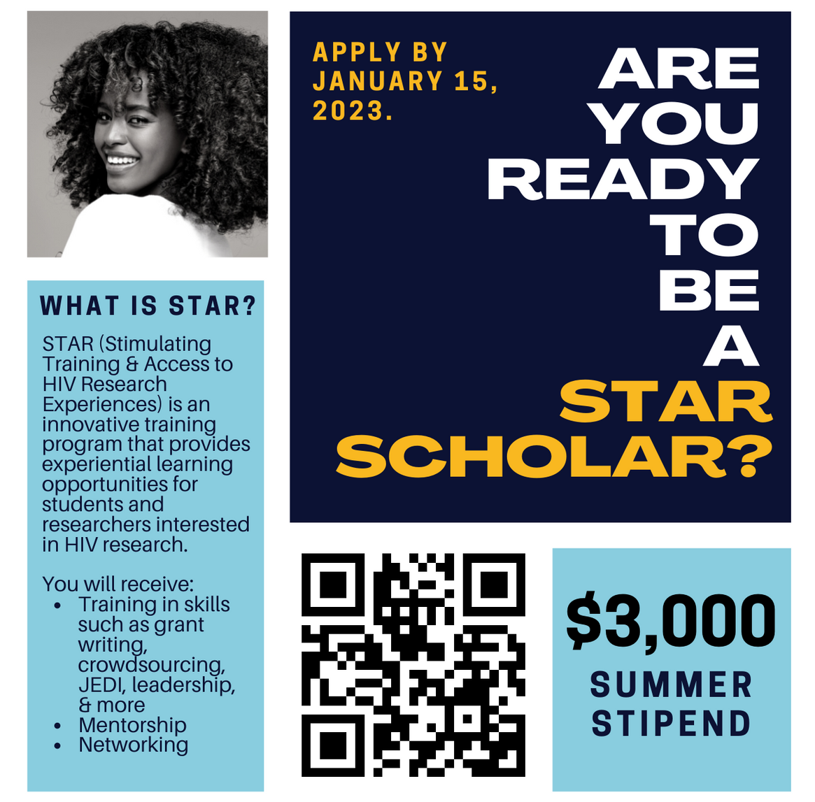
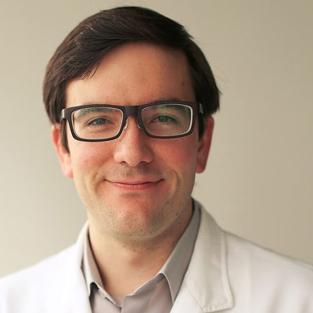
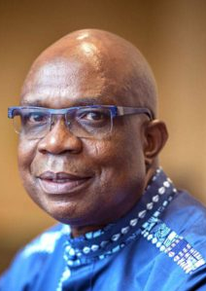
Stimulating Training and Access to HIV Research Experiences - STAR

Slide 21
"You have to act as if it were possible to radically transform the world. And you have to do it all the time.“
- Angela Davis
Notes:
a decolonized psychology begins with partnerships – folks have been there before we need to learn from each other. Covid-19 taught us many lessons, let’s not return to status quo but instead let’s re-imagine and re-build the science we want psychology to be and partner to dismantle barriers and co-create this new science.
So I leave you with this quote from Angela Davis which she spoke during a 2014 lecture at Southern Illinois University – you have to act …
I contend that psychology must partner with other fields to develop new resources and avenues that can anticipate what is needed to serve ALL of our communities. Now is the time.

Slide 22
From our time today, what is one thing you want to hold on to?
Notes:
What three steps will you take?
When will you take your first step?
Who will you tell about it?

Slide 23
Acknowledgments!
My amazing co-authors
Juliet Iwelunmor, PhD
Margarita Alegria, PhD
Research staff and students at SLU, MGH, & TAMU
The incredible community members who participate in our projects and the amazing community partners who link arms with us
Funders
NIAID R25AI170379
Robert Wood Johnson Foundation
Thank
you!
www.changelabtexas.com
Twitter: @Idia_T
@changelabtexas

Slide 24
References
American Psychological Association. (2021, December). Equity, diversity, and inclusion toolkit for journal editors. https://www.apa.org/pubs/authors/equity-diversity-inclusin-toolkit-journal-editors.pdf
Bañales, J., Pinetta, B. J., Singh, S., Rodriguez, A. J., Aldana, A., Gutierrez, F. J. (2023). Centering youth voice in developmental science: A research roadmap for partnerships with Latinx youth. In D. P. Witherspoon & G. L. Stein (Eds.), Diversity and developmental science (pp. 197-221). Springer, Cham. https://doi.org/10.1007/978-3-031-23163-6_9
Bowleg, L. (2021). "The master's tools will never dismantle the master's house": Ten critical lessons for Black and other health equity researchers of color. Health Education & Behavior, 48(3), 237–249. https://doi.org/10.1177/10901981211007402
Buchanan, N. T., Perez, M., Prinstein, M. J., & Thurston, I. B. (2021). Diversity Accountability Index for Journals (DAI-J): Increasing awareness and establishing accountability across psychology journals. PsyArXiv. https://psyarxiv.com/zp9em
Buchanan, N. T., & Wiklund, L. O. (2021). Intersectionality research in psychological science: Resisting the tendency to disconnect, dilute, and depoliticize. Research on Child and Adolescent Psychopathology, 49(1), 25–31. https://doi.org/10.1007/s10802-020-00748-y
Carter-Sowell, A. R., Vaid, J., Stanley, C. A., Petitt, B., & Battle, J. S. (2019). ADVANCE scholar program: Enhancing minoritized scholars’ professional visibility. Equality, Diversity and Inclusion, 38(3), 305–327. https://doi.org/10.1108/EDI-03-2018-0059
Chávez, V., Duran, B., Baker, Q. E., Avila, M. M., & Wallerstein, N. (2008). The dance of race and privilege in CBPR. In M. Minkler & N. Wallerstein (Eds.), Community based participatory research for health (2nd ed., pp. 91–105). Jossey-Bass.
Evans, K. N., Martinez, O., King, H., Van den berg, J. J., Fields, E. L., Lanier, Y., Hussen, S. A., Malavé-Rivera, S. M., Duncan, D. T., Gaul, Z., & Buchacz, K. (2023). Utilizing community based participatory research methods in Black/African American and Hispanic/Latinx communities in the US: The CDC minority HIV research initiative (MARI-Round 4). Journal of Community Health, 1–13. Advance online publication. https://doi.org/10.1007/s10900-023-01209-5
Flanagin, A., Frey, T., Christiansen, S. L., & Bauchner, H. (2021). The reporting of race and ethnicity in medical and science journals: Comments invited. Journal of the American Medical Association, 325(11), 1049–1052. https://doi.org/10.1001/jama.2021.2104

Slide 25
References
Galán, C. A., Bekele, B., Boness, C., Bowdring, M., Call, C., Hails, K., McPhee, J., Mendes, S. H., Moses, J., Northrup, J., Rupert, P., Savell, S., Sequeira, S., Tervo-Clemmens, B., Tung, I., Vanwoerden, S., Womack, S., & Yilmaz, B. (2021). Editorial: A call to action for an antiracist clinical science. Journal of Clinical Child and Adolescent Psychology, 50(1), 12–57. https://doi.org/10.1080/15374416.2020.1860066
Howard, M. C., & Hoffman, M. E. (2018). Variable-centered, person-centered, and person-specific approaches: Where theory meets the method. Organizational Research Methods, 21(4), 846–876. https://doi.org/10.1177/1094428117744021
McNeal, D. M., Glasgow, R. E., Brownson, R. C., Matlock, D. D., Peterson, P. N., Daugherty, S. L., & Knoepke, C. E. (2020). Perspectives of scientists on disseminating research findings to non-research audiences. Journal of Clinical and Translational Science, 5(1), e61. https://doi.org/10.1017/cts.2020.563
O’Reilly, M. (2020, June 5). Systems centered language: Speaking truth to power during COVID-19 while confronting racism. Medium. https:// medium.com/@meagoreillyphd/systems-centered-language-a3dc7951570e
Råbu, M., McLeod, J., Tønnessen, T. B., & Moltu, C. (2022). Creating art from research: A theatre play based on research interviews with senior therapists. British Journal of Guidance & Counselling, 50(1), 82–94. https://doi.org/10.1080/03069885.2020.1755419
Roberts, S. O., Bareket-Shavit, C., Dollins, F. A., Goldie, P. D., & Mortenson, E. (2020). Racial inequality in psychological research: Trends of the past and recommendations for the future. Perspectives on Psychological Science, 15(6), 1295–1309. https://doi.org/10.1177/1745691620927709
Society of Pediatric Psychology. (n.d.). JPP mentoring program for junior reviewers. https://pedpsych.org/junior-reviewers/
Schulz, A. J., Israel, B. A., Reyes, A. G., Wilkins, D., Batterman, S. (2023). Promoting health equity with community-based participatory research: The community action to promote healthy environments (CAPHE) partnership. In D. Jourdan & L. Potvin (Eds.), Global handbook of health promotion research (pp. 251-262). Springer, Cham. https://doi.org/10.1007/978-3-031-20401-2_20
Williford, D. N., McTate, E. A., Hood, A. M., Reader, S. K., Hildenbrand, A. K., Smith-Whitley, K., Creary, S. E., Thompson, A. A., Hackworth, R., Raphael, J. L., & Crosby, L. E. (2023). Psychologists as leaders in equitable science: Applications of antiracism and community participatory strategies in a pediatric behavioral medicine clinical trial. The American Psychologist, 78(2), 107–118. https://doi.org/10.1037/amp0001086
Valrie, C., Thurston, I., & Santos, M. (2020). Introduction to the special issue: Addressing health disparities in pediatric psychology. Journal of Pediatric Psychology, 45(8), 833–838. https://doi.org/10.1093/jpepsy/jsaa066
Yang, T. C., & Chen, D. (2018). A multi-group path analysis of the relationship between perceived racial discrimination and self-rated stress: How does it vary across racial/ethnic groups?. Ethnicity & Health, 23(3), 249–275. https://doi.org/10.1080/13557858.2016.1258042

